Slide 1


Achyut Prasad D.C.
Final Project

Slide 2
Twitter Sentiment Analysis using CNN
1
Leveraging Deep Learning
2
Capturing Nuanced Emotions
This project utilizes Convolutional Neural Networks (CNNs), a powerful deep learning technique, to analyze sentiment in Twitter data.
CNNs can identify complex patterns in text, allowing for a more nuanced understanding of the emotional tone behind tweets.
3
Improving Customer Insights
4
Real-time Monitoring
The sentiment analysis can provide valuable insights into customer opinions, enabling businesses to better understand their audience.
The system can track sentiment in real-time, allowing for quick responses to emerging trends and issues.

Slide 3
Agenda
Introduction
Problem Statement
An overview of the project, its objectives, and the key topics to be covered.
Defining the challenge that the project aims to address and the importance of solving it.
Project Overview
Solution Walkthrough
A high-level summary of the proposed approach and the technologies used.
Delving into the details of the solution, its key features, and the value it provides.

Slide 4
Project Statement
Twitter, the popular social media platform, has become a goldmine of user sentiment data. However, manually analyzing the millions of tweets posted daily to gauge public opinion on various topics is a daunting task.
The aim is to develop an automated Twitter sentiment analysis system using Convolutional Neural Networks (CNN) that can accurately predict the sentiment (positive, negative, or neutral) of tweets in real-time.
By automating sentiment analysis, we can save time and resources while gaining real-time insights into public opinion.

Slide 5
Project Overview
This project focuses on developing a Twitter sentiment analysis model using Convolutional Neural Networks (CNN).
The goal is to build a deep learning system that can accurately classify tweets as positive, negative, or neutral based on their textual content.
The project will involve collecting a large dataset of labeled tweets, preprocessing the data, and training a CNN model to learn the patterns and features that distinguish different sentiment polarities.
The model will then be evaluated on a test set to measure its performance.

Slide 6
Who are the end users?
The primary end users for this Twitter Sentiment Analysis solution are business owners and marketing teams who need to understand customer sentiment and sentiment trends around their brand or products.
Secondary users could include social media managers, market researchers, and customer service teams who analyze online conversations to gain insights and drive business strategy.
The solution would also benefit data scientists and AI/ML researchers who are interested in applying advanced natural language processing techniques to real-world challenges.

Slide 7

Your Solution and its Value Proposition
Utilize and compare various methods for sentiment analysis on tweets
Train and test the model using a CSV file with tweet_id, sentiment, and tweet
Automate sentiment analysis to save time and resources
CNN-based Twitter sentiment analysis gives quick insights into public feelings, aiding timely responses.
They are scalable great at accurately understanding sentiments in tweets, even with slang or typos.

Slide 8
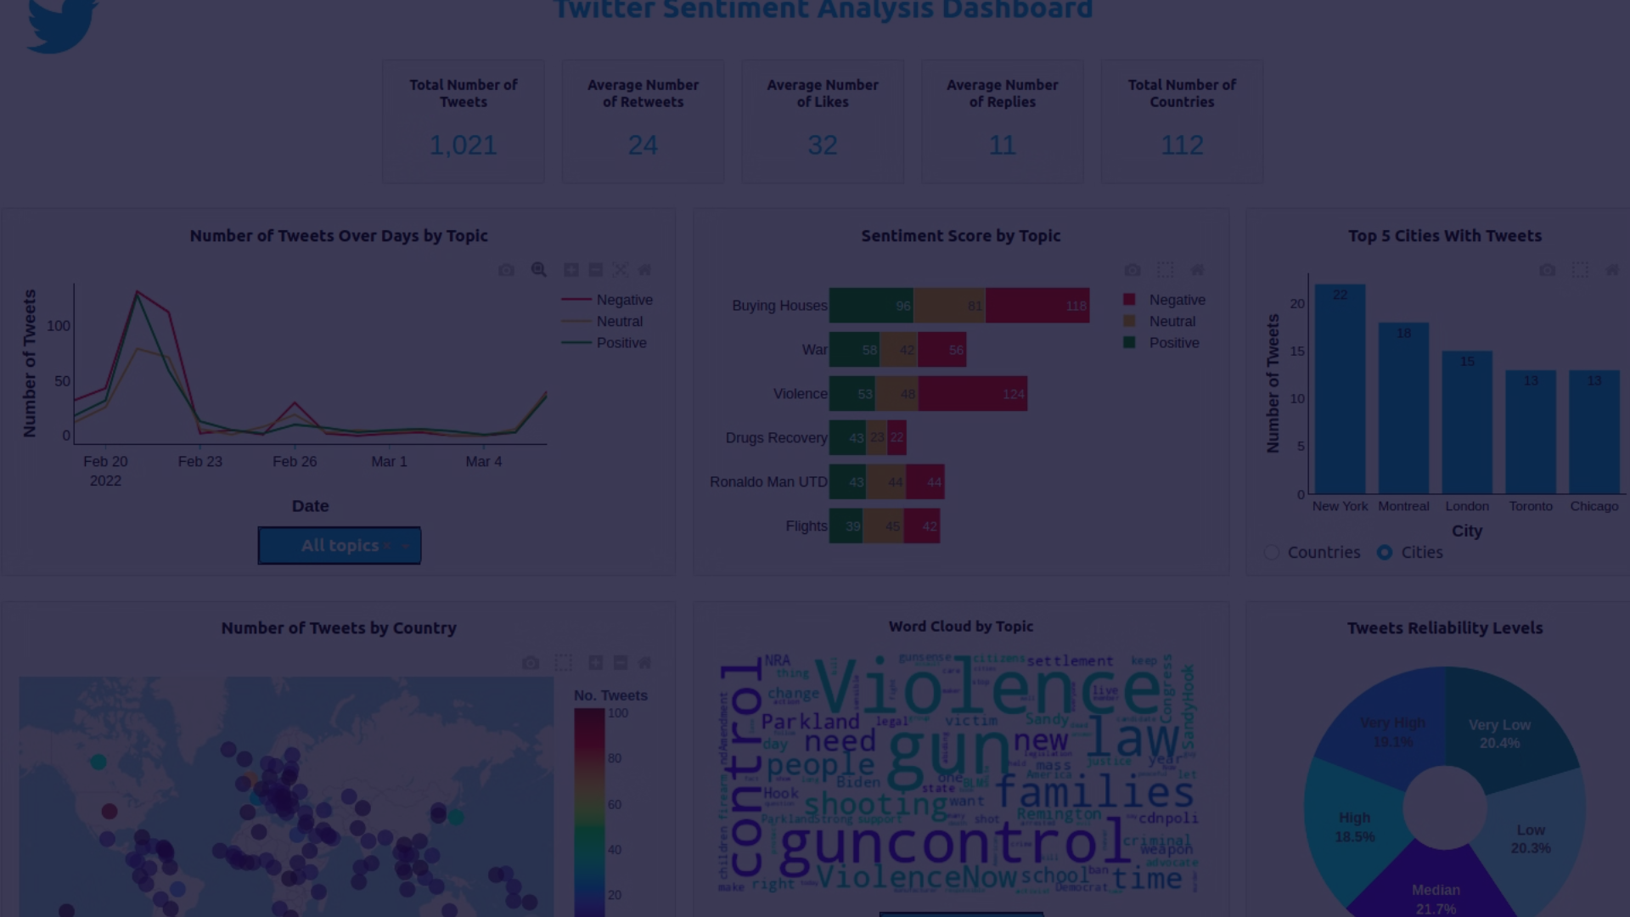
The Wow in your solution
1
Cutting-Edge Neural Networks
2
Real-Time Monitoring
3
Intuitive Visualizations
Our solution leverages the power of n convolutional neural networks (CNNs) to analyze sentiment in Twitter data, delivering highly accurate and robust results.
With our platform, users can monitor sentiment trends on Twitter in real-time, enabling them to quickly identify and respond to emerging issues or opportunities.
Our interactive dashboards provide visually stunning and easy-to-interpret visualizations of sentiment data, empowering users to uncover valuable insights at a glance.

Slide 9
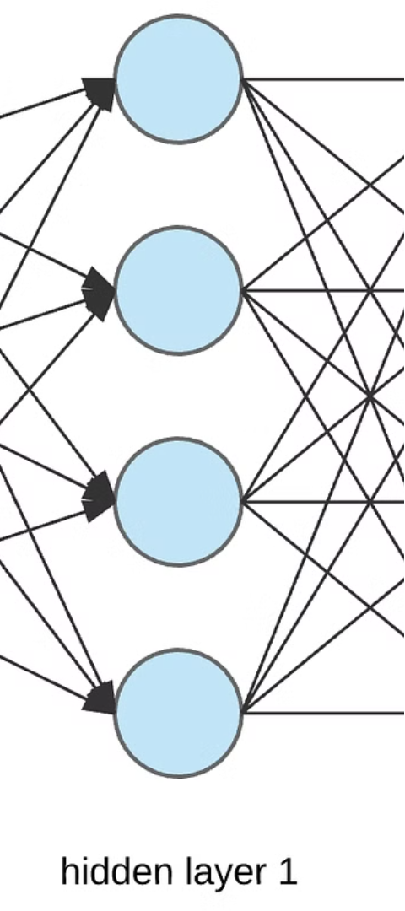
Modeling
1
Data Collection
Gathered a large dataset of Twitter posts, with positive and negative sentiments labeled.
2
Model Architecture
Designed a Convolutional Neural Network (CNN) model to analyze the text and classify the sentiment.
3
Model Training
Trained the CNN model on the labeled dataset, optimizing hyperparameters to achieve high accuracy.

Slide 10

Results
Our CNN model achieved a high level of accuracy in sentiment analysis of Twitter data.
Real-time monitoring allowed us to identify trends and respond to emerging issues promptly.
Intuitive visualizations helped users easily understand complex sentiment data.
Demo Link: https://github.com/example/sample.

